Slide 1
HUMOR ANALYSIS
Project Members:
Chaithra Bangalore Venkatesh
Jonathan Ishii
Rob Hackemack
Class – 583-01 (14062)
Guided By:
Prof. Dr. Anand Panangadan

Slide 2

Introduction
Humor is a psychological response characterized by the positive emotion of amusement, the appraisal that something is funny, and the tendency to laugh.
Due to its vast applications and increasing popularity on social media platforms, enabling computers to process humour has become very crucial.

Slide 3
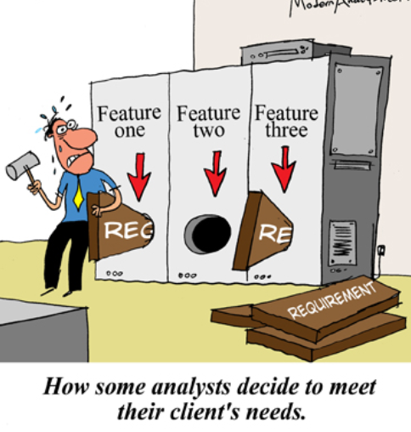
Project Goal
Analysis of humour by employing prolog techniques for humour detection.

Slide 4

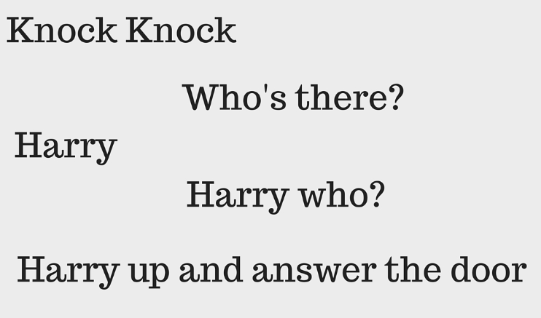
Knock Knock Jokes
Question-and-answer joke, typically ending with a pun.
Children’s jokes.
Scenario is of a person knocking on the front door to a house.
Example:

Slide 5
System Architecture
User Input
Jokes
GUI
Jokes
T/F Output
Query
Swipl
Sub-Process
T/F Output

Slide 6

Demo

Slide 7
Challenges
How to have the GUI interact with Prolog.
This was difficult because there are no libraries to interact with Prolog in python without creating a new environment.
Solution: Used subprocess to communicate between python and swipl
List processing of the Knock-knock jokes.
How to process lists of data in Prolog, such that a function can have a list as an argument.
Solution: Compartmentalized lists into smaller subcomponents to increase the ease of analysis.
Processing of knock-knock jokes for homonyms.
How can you decide whether a knock knock joke is funny or not?
No straightforward way of determining such a thing.
Solution: Generalized homonyms into a list and compared if atleast one elements existed in the other list.

Slide 8
Future Recommendations
Retrieving and suggesting other knock-knock jokes if the output returns true.
Analyzing other varieties of jokes like sarcasm, pun, irony and exaggeration.

Slide 9


